Slide 1


First Half 2019
Operating and Financial Results

Slide 2
Commitment to Sustainability, Relevance and Impact
Sustainability: A commitment to long term financial health.
None of our work is possible if we don’t remain financially healthy. Sustainability requires that we establish core indicators of corporate health, that we measure our performance against those indicators, and we build strategies and structures to ensure success.
Sustainability advances our ability to innovate and stay relevant.
Relevance: A commitment to continuous innovation and modernization.
An organization must remain ahead of the curve—understanding the emerging trends in practice, funding and technology, and their impact on service design and delivery. We simply cannot do what we have always done.
Relevance means that we are positioned to thrive regardless of the inevitable twists and turns of the marketplace.
Impact: A commitment to measurable improvements.
Because we are committed to solving (not just serving) problems, we have set bold goals to improve the long-term outcomes for specific populations. We measure our success by tracking the national outcomes of these groups, not just those who walk through our door.
We are embedding research into our program models and then replicating and scaling our evidence-based interventions.

Slide 3
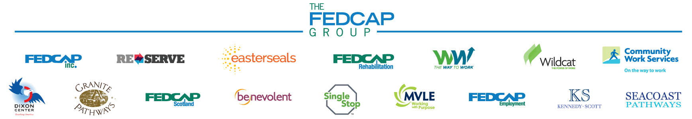
Our Mission
The Fedcap Group is committed to improving the long-term social and economic well-being of the vulnerable and disadvantaged.
Occupational Health
Workforce Development
Economic Development
Education
A GROWING NUMBER OF TOP TIER BRANDS
SERVICES ARE DELIVERED THROUGH FOUR AREAS OF PRACTICE

Slide 4

First Half FY 2019 Performance Aligned with Strategic Objectives
Achieved industry‐leading outcomes for individuals with barriers to economic well-being
Sustained and grew our expertise in core markets
Leveraged successful programs in new formats and new geographies
Utilized technology across practice areas to engage populations and measure results
Served as a growth platform for like-minded organizations with synergistic missions

Slide 5
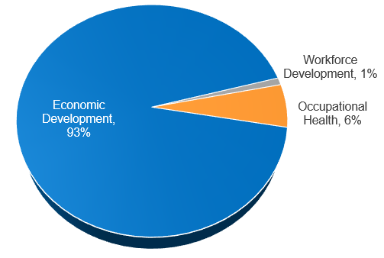
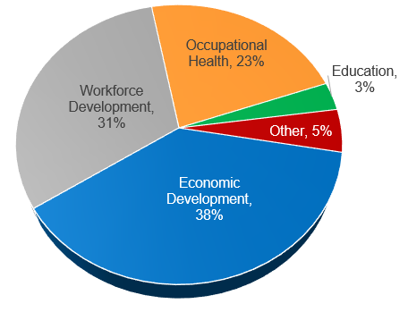
Revenue Diversification
In 2010 Economic Development (Facilities Management, Home Health, Manufacturing) made up 93% of our total revenue
FY 2019 Economic Development represented 38% of our total revenue, well-balanced by Workforce Development (31%) and Occupational Health (23%)
Revenues increased more than 300% during the 2010-2019 period, with growth in all Practice Areas
1st Half 2010
$35.9MM
1st Half 2019 $145.3MM

Slide 6
Key Areas of Focus
Provided Services To 150,000 Children, Youth and Adults
Expanded Key Areas of Focus:
  Early Childhood Services
  Criminal Justice
  Managed Care Contracts
  Substance Use Disorder
  Employment of People With Disabilities
International Growth and Expansion
Continued Expansion of Technology to serve more people and enhance impact.

Slide 7
Highlights First Half FY 2019: KEY AREAS OF FOCUS
Early Childhood Services
  Served 3500 children and youth with disabilities ages 0-14 (2904 children 0-6 y/o) preparing them to enter school and graduate from high school
  Over 3000 youth were impacted through our partnership with the Rhode Island Department of Education—helping teachers learn how to prepare youth with disabilities to transition to college and careers.
Expanded work with the Criminal Justice Population offering housing and employment services for the justice involved. This is in addition to our Women’s Project and our work inside Rikers Island that supports successful transition to the community through work readiness, job placement and coordination across multiple systems and providers.
  We are currently serving 2,667 individuals with justice involvement annually spanning multiple programs across three companies of The Fedcap Group: Wildcat, Fedcap, Inc., and Fedcap Rehabilitation Services.
Awarded Managed Care Contracts – In New Hampshire, Texas and New York
Won new contracts focusing on employment as part of our holistic efforts to combat the opioid crisis and other Substance Use Disorders

Slide 8
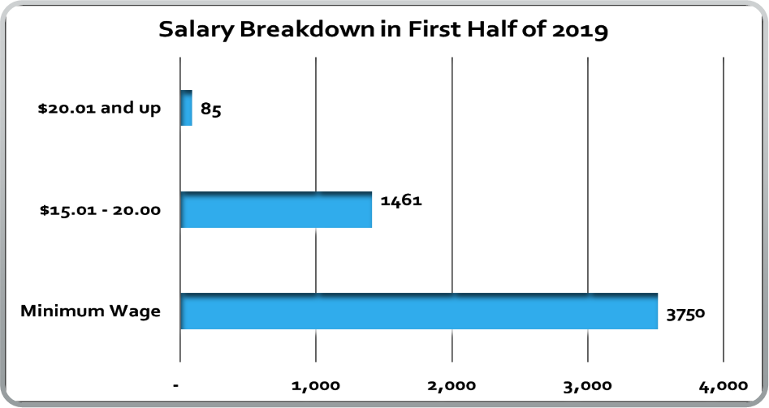
Key Area of Focus: Employment of Individuals with Disabilities and Other Barriers
Placed 5946 people with disabilities and other barriers in jobs –26% above minimum wage
  Employed 1700 individuals with barriers in our own commercial businesses with contracts throughout the eastern seaboard . Average pay of $33,700.00
  Helped 246 individuals with a criminal justice background find jobs.
  Helped 2700 people with physical, intellectual and developmental disabilities find jobs.
  Assisted 1300 chronically unemployed individuals obtain stability and employment

Slide 9

International Expansion
Expansion of efforts in the UK serving 7396 people annually
  Completed combination with Kennedy Scott
  Establishment of Fedcap Employment
  Establishment of Fedcap Scotland

Slide 10


Leverage Technology to Expand Impact
In the first half of FY 2019, Single Stop connected 44,866 people to benefits-- drawing down $177,863,724.
Single Stop is building networks of community based agencies working together to meet the needs of the whole person and family through eligibility screening, benefit drawn down and referrals to critically needed services.
Single Stop is changing college persistence rates. In the first half of FY 2019 we served 3067 students on 33 campuses across 10 states.
Research studies validated a 13 percentage point increase in college persistence with Single Stop support.
  First Time in College students who utilized Single Stop graduated at rates that were double that of their peers.
Since 2007 when it was launched, Single Stop has served 1,959,931 million households drawing down $6,261,885,258 in benefits – creating a springboard for long-term financial stability.

Slide 11


First Half FY 2019
Financial Performance

Slide 12
Capacity to Support Growth and Expansion
CAGR 16.3% (FY14-FY19)
Fedcap has achieved a 5-year compound annual growth rate of 16.3% from 2014 - 2019
First Half FY 2019 revenues of $145.3MM are $13.1MM greater than First Half FY 2018
Credit lines totaling $28MM - Available for working capital needs
FY 2019 Total Assets exceeded $173.7MM with approximately 46% in Fixed Assets

Slide 13
First Half 2019 Financial Review
9.9% year‐on‐year growth in total 1st Half revenues, driven by acquisition growth.
1st Half FY 2019 acquisition growth contributed $17.3M or 12% to total revenues and included $2.1M from international operations started in FY 2019.
Workforce Development and Economic Development accounted for over $100MM or 69% of total 1st Half FY 2019 Fedcap revenues.
FY 2019 program expenses accounted for 88% of operating expenses.
The FY 2018 acquisitions of MVLE, ESCTx., and ESNTx. accounted for $15.2MM in 1st Half FY 2019 revenue with a full year FY 2019 revenue outlook of $32MM.
1st Half FY 2019 “EBIDA” of $5.2MM increased 40% from $3.7MM in the prior year.
Investment Fund increased to $16.7MM or 9.2% over prior year.

Slide 14
Balance Sheet Highlights
($MM) | 1st Half 2014 | 1st Half 2015 | 1st Half 2016 | 1st Half 2017 | 1st Half 2018 | 1st Half 2019
Cash and Investments | $8.1 | $21.8 | $27.9 | $29.3 | $24.7 | $23.3
Total Assets | $67.8 | $115.7 | $145.9 | $146.3 | $155.1 | $173.7
Long-Term Debt | $29.8 | $54.0 | $79.2 | $78.6 | $75.7 | $97.6
Net Assets | $18.9 | $34.9 | $34.9 | $35.5 | $35.6 | $37.2
Long-Term Debt includes the following:
FY 2015 – includes mortgage on headquarters’ and capital lease on “service” campus.
FY 2019 – includes renewal and increase in working capital line of credit to $28 million.

Slide 15
Key Financial Ratios
Income Statement
Operating Margin: 0.13%
Personnel Cost Ratio: 62%
Balance Sheet
Debt Coverage Ratio: 2.1
Current Ratio: 2.17
Average DSOs: 66 Days
Program Expense Ratio: 88%

Slide 16
Summary
Reputation
Recognized subject matter experts in key markets: Economic Development, Workforce Development, Education and Occupational Health
Credible, reliable top performer
Financial Strength & Growth Potential
Strong Balance Sheet
Growing Family of Brands benefits from added qualifications and expertise
Engagement
Positive client outcomes result in increasing individual and corporate donors, business partnerships and foundation support
Talent & Technology
Significant investment in human capital, technology and infrastructure

