Slide 1

FY 2018 Operating and Financial Results
The Fedcap Group

Slide 2

Our Mission
The Fedcap Group is Committed to Advancing The Economic And Social Well-being Of The Impoverished And Disadvantaged
Practice Areas Operating within An Integrated Regional Framework:
Occupational Health
Workforce Development
Economic Development
Education
Work Flowing Through a Growing Number of Companies
Community Work Services
Easterseals-New York, Rhode Island, Central Texas, North Texas
Granite Pathways
MVLE
ReServe
Single Stop
Wildcat
Kennedy Scott
Benevolent
Fedcap Rehabilitation Services, Inc.
Fedcap Inc. – a new company established to house our growing portfolio of workforce/TANF contracts
Community Impact Institute

Slide 3
FY 2018 Performance Aligned With Strategic Objectives
Achieved industry‐leading outcomes for individuals with barriers to economic well-being
Sustained and grew our distinctive expertise in core markets
Leveraged successful programs in new formats and new geographies
Utilized technology across practice areas to engage populations and measure results
Served as a growth platform for like-minded organizations with synergistic missions

Slide 4
Launching of The Fedcap Group
Established to serve as parent company to our growing group of mission- driven top tier nonprofit agencies.
Platform for sustainable growth and expansion.
Provision of Corporate Services to include: Finance, HR, Facilities, IT, and Engagement.

Slide 5
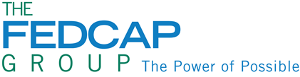
Strong Growth in Number of People Served Across an Expanded Geographic Footprint

Slide 6
2018: A Year of Balanced Organic and
Acquisition Growth
Combinations finalized with mission-driven agencies such as MVLE in Northern Virginia, and Easterseals’ in Central and Northern Texas.
Expanded our model workforce program to Washington DC: 2 new contracts totaling $4,4430,000 annually serving 300+ individuals.
Expansion of our work inside Rikers Island—building a replicable model that supports successful transition to the community through work readiness, job placement and coordination across multiple systems and providers.
Expanded partnership with Amazon —placing 100 people with disabilities within 12 states.
Significant expansion of efforts in New Hampshire – awarded two important contracts to fight opioid crisis.
Continue to grow our Single Stop presence in Community Colleges –currently operating in 27 colleges across 10 states. Research studies validated a 13% increase in college persistence with SS support.
Significant expansion of our work with the NYC Department for the Aging– awarded an annual contract of $2.3M placing older workers (ReServists) in 24 city agencies.
6

Slide 7


Combinations that Further Advance our Collective Capacity
Easterseals Central TX
1
Easterseals North TX
2
MVLE-Northern VA
3

Slide 8
Easterseals Platform
Every 4 ½ minutes, a baby is born with a birth defect in the United States—120,00 babies each year.
Among persons ages 16 to 64, 70.7% of individuals with disabilities are unemployed.
Nationally Easterseals is making a profound difference through its network of 72 high performing affiliates— serving 1.5 million people with disabilities and their families each year.
Services include Early Intervention, Child Development, Pediatric Rehabilitation, Special Education, Employment, services for Veterans, and Older Workers.
During the year, we combined with Easterseals Central Texas and Easterseals North Texas and were awarded the rights to establish Easterseals locations in Mississippi, Oklahoma and South Dakota.
  Our collective Easterseals serves 6000 children and adults through the efforts of 810 staff.
  Of those 4561 are children with disabilities--- providing a tremendous opportunity to test innovations in service delivery that are aspirational in nature—laying the foundation for children with disabilities to successfully transition to adulthood, college and careers.

Slide 9
Close out of NYC WeCARE
Leveraging Fedcap CARES technology through licensing fees to new WeCARE contractors totaling $1.5 million annually.
Providing sub-contracting services in the boroughs of the Bronx and Queens with contracts totaling $19.4M over the next three years with a potential for an additional three year renewal.
Total number of jobs in the life of the contract over the course of six years: 17,500.

Slide 10
Granite Pathways: Combatting the NH Opioid Crisis
Granite Pathways, a company of The Fedcap Group, is a growing force in the fight against the opioid crisis in NH.
GP won a contract to design, implement and manage a one of a kind residential care program for 30 youth ages 16-24, struggling with substance use disorders.
  Program is located on the grounds of the Sununu Center in Manchester NH.
  Anticipate serving 150 youth and young adults annually.
Also awarded a contract to serve as screening and referral HUB for southern part of the state—building from our statewide screening and referral work.
  Services are expected to go live as of January 1, 2019.

Slide 11
FY2018
Expanding Poverty Fighting Efforts
In FY 2018, 28% of individuals who achieved employment earned a salary of $16.01 per hour or more. The Fedcap Group remains committed to “moving the needle” when it comes to helping individuals find employment with competitive salaries and is eager to see future growth in this area.
In FY 2018 Single Stop served 205,214 people drawing down $530,270,555 in benefits.
Since 2007 when it was launched, Single Stop has served over 1.9 million households drawing down $5.9B in benefits –creating a springboard for long-term financial stability and a pathway to the middle class.
In FY 2018, 6430 people who did not believe they were well enough to go to work, received health and behavioral health services , stabilized and entered the workforce.

Slide 12
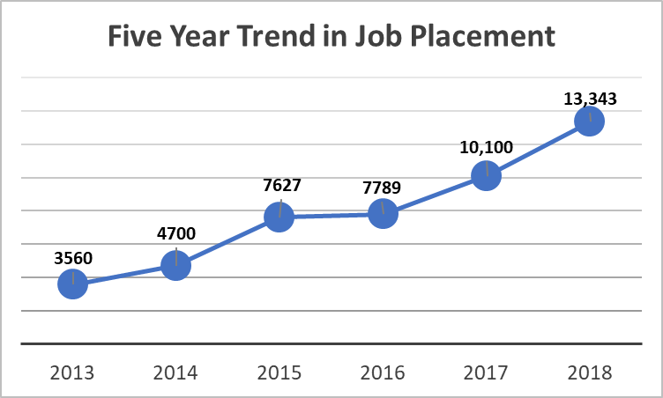
Employment Statistics

Slide 13
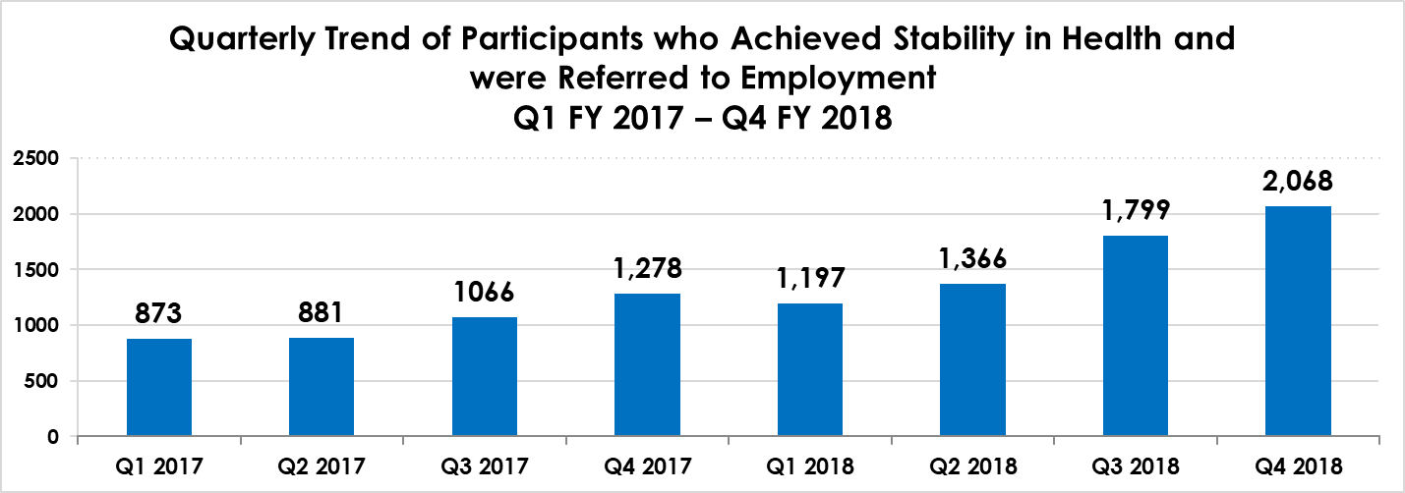
In FY 18, 6430 people received wellness services, stabilized and were able to go to work.

Slide 14
2018
Financial
Performance

Slide 15
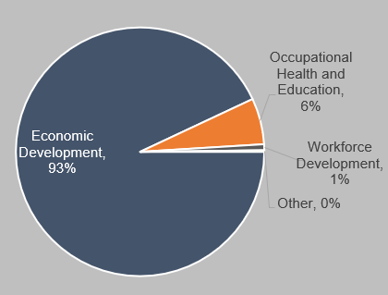
Revenue Diversification
Revenue Diversification FY 2010
In 2010 Economic Development (Facilities Mgt., Home Health, Manufacturing) made up 93% of our total revenue.
By the end of FY 2018 Economic Development represented 33% of our total revenue, well-balanced by Workforce Development and Occupational Health.
Total 2018 revenues increased more than 300% during the 2010-2018 period, with growth in all Practice Areas.
Revenue Diversification FY 2018

Slide 16
Capacity to Support Growth and Expansion
Fedcap has a 5-Year compound annual growth rate of over 18% from 2013 – 2018.
Full Year 2018 revenues are $37.3MM greater than Full Year 2017 actual.
Credit lines totaling $18 million - Available for working capital needs
FY 2018 Total Assets exceeded $177MM with approximately 46% in Fixed Assets.

Slide 17
Full Year 2018 Financial Review
Year over Year revenue growth of 14.4% , driven by both organic and acquisition growth.
Workforce Development and Economic Development accounted for over $217.8MM or 73% of total FY 2018 Fedcap revenues.
FY 2018 program expenses accounted for 88% of operating expenses.
Through FY 2018 combinations, $35MM will drive future revenue synergies.
Full Year 2018 “EBITDA” of $8.5MM, an increase $1MM from FY 2017 of $7.5MM.
Investments at year end FY2018 totaled $22.3MM, inclusive of the $12.1MM Investment Fund, with 10% growth since inception, and $5MM of Trust accounts through acquisition.

Slide 18
Balance Sheet Highlights
FY 2015 Long-Term Debt included the Headquarters’ mortgage and capital lease on “service” campus.
FY 2017 Long-Term Debt excluded $14.7MM LOC classified to Short Term for presentation.
FY 2018 Long-Term Debt includes $10MM Bond plus the LT Debt of the acquired companies.

Slide 19
Key Financial Ratios
Income Statement
Operating Margin: 0.17%
Personnel Cost Ratio: 58%
Balance Sheet
Debt Coverage Ratio: 3.03
Current Ratio: 1.49
Average DSOs: 61 Days
Program Expense Ratio: 88%

Slide 20
Looking Ahead
The Fedcap Group provides a platform of service and solutions across an expanding national and international footprint.
1
Growing business development pipeline to drive future organic growth
2
Opportunities for additional business combinations position us to significantly expand the size and scope of our operations in 2018 and beyond.
3

Slide 21
Summary
Reputation
Recognized subject matter experts in key markets: Economic Development, Workforce Development, Education and Occupational Health
Credible, reliable top performer
Financial Strength & Growth Potential
Strong Balance Sheet
Growing Family of Brands benefits from added qualifications and expertise
Engagement
Positive client outcomes result in increasing individual and corporate donors, business partnerships and foundation support
Talent & Technology
Significant investment in human capital, technology and infrastructure

